Slide 1

SD Card via SPI
rev1.0 24/03/2020

Slide 2
GOAL
Manage files in a SD card via SPI: Read, Write and Remove files from SD cards

Slide 3
PREREQUISITES
Software needed:
STM32IDE
Hardware used in this example:
NUCLEO-F446ZE
SPI SD CARD Module

Slide 4
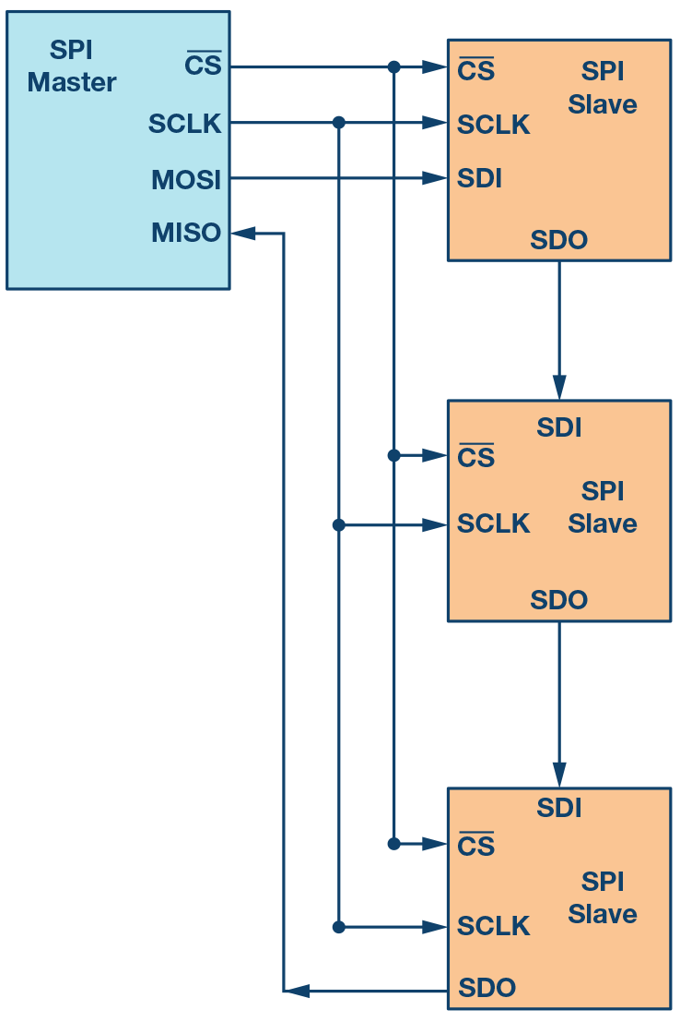
SPI (Serial Peripheral Interface)
The Serial Peripheral Interface (SPI) is a synchronous serial communication interface specification used for short-distance communication.
SPI devices communicate in full duplex mode using a master slave architecture with a single master. Multiple slave-devices are supported through selection with individual chip select (CS) lines.

Slide 5
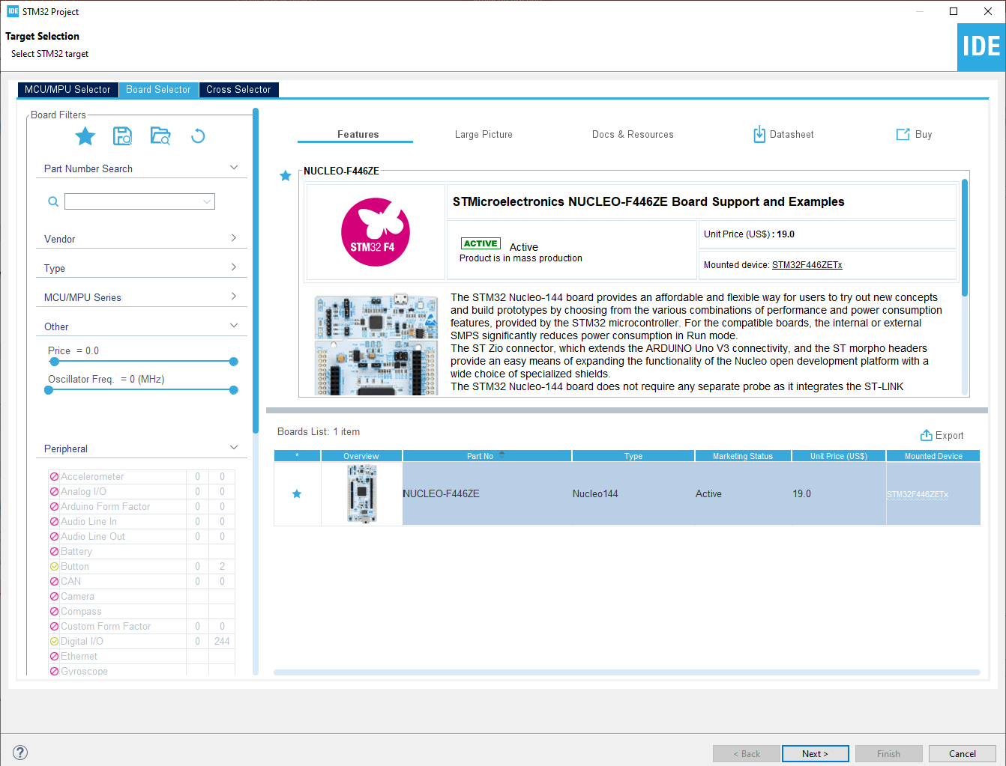
Start a new project
From the stm32IDE software click on File -> New -> STM32 Project.
Select your board or your uC and click next.

Slide 6
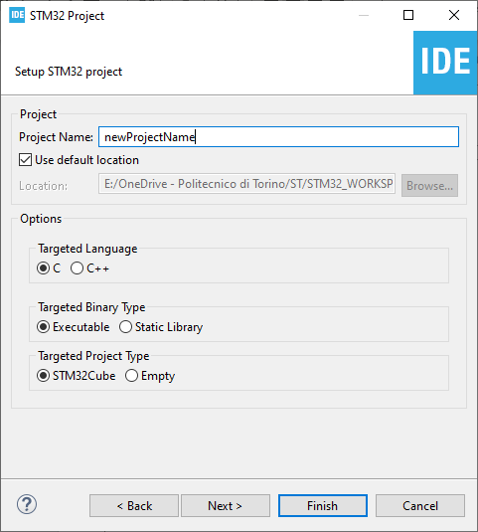
Start a new project
Type the name of your project and click next.
By default the project will be created in the workspace folder.

Slide 7
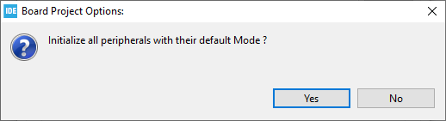
Start a new project
Type the name of your project and click next.
By default the project will be created in the workspace folder.
The STM32IDE has the option to initialize all the peripheral with their default mode:
Clicking Yes the USART3, all the LEDs and the blue UserButton will be configured as default.
Click Yes.

Slide 8
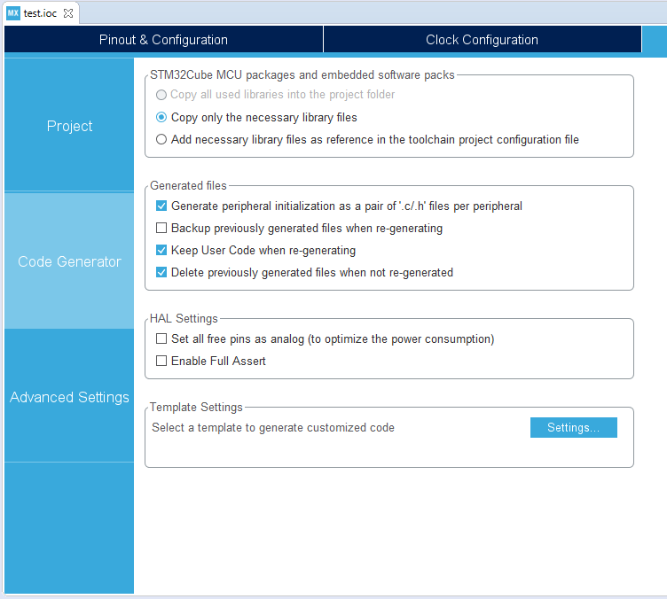
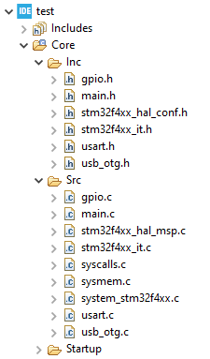
Project Manager
In the Code Generator Tab check the Generate peripheral initialization […] box: each periperhal will have a disting periph.c and periph.h files.

Slide 9
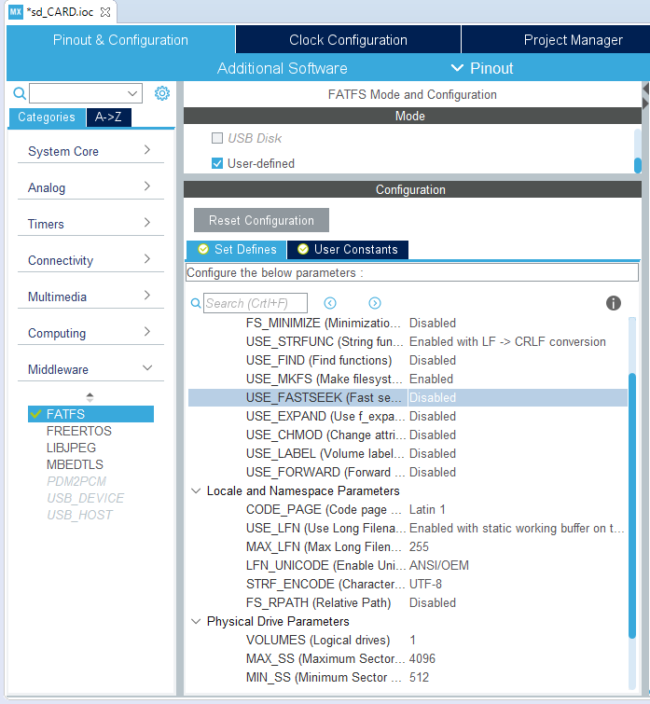
FATFS Configuration
Under the middleware section select FATFS then check User-defined Mode.
Pay attenction for all the configuration setting, in particular the ones indicated by the arrows:
USE_STRFUNC : enabled with LF->CRLF conversion
CODE_PAGE : Latin1
USE_LFN : Enabled with static working buffer […]
MAX_SS : 4096
MIN_SS : 512

Slide 10
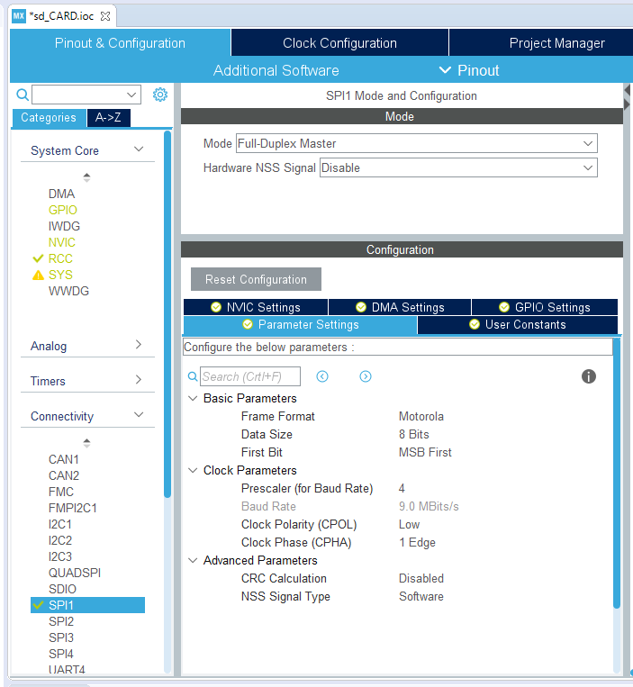
SPI Configuration
For this example we use the SPI1 bus.
Go under connectivity -> SPI1 and enable it in Full-Duplex Master.
Set the prescaler in order to have a BaudRate around 9 MBits/s (7-12 Mbits/s are resonable values).

Slide 11
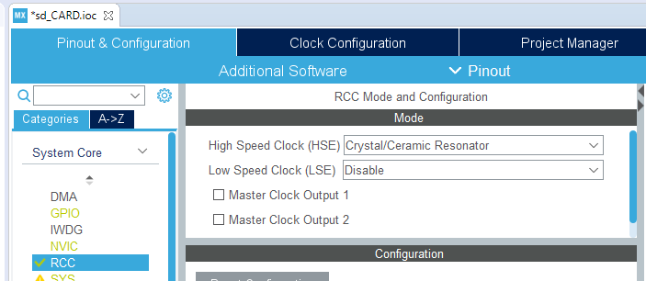
RCC configuration
In our case we need a prescaler of 4 since we have configured the RCC and the clock in this way:
High Speed Clock (HSE) : Crystal/Ceramic Resonator
HCLK (in the clock configuration tab) : 72MHz

Slide 12
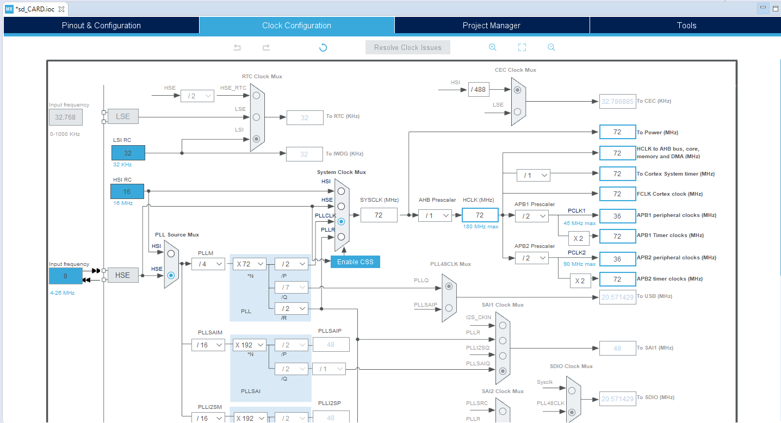
Clock Configuration

Slide 13
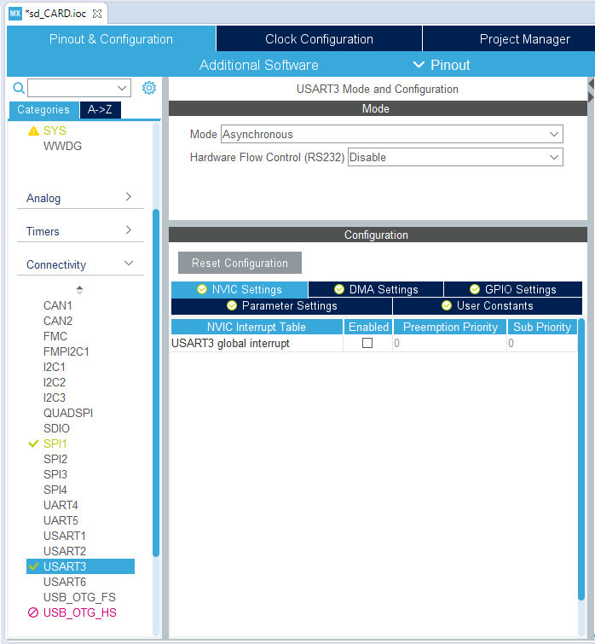
USART Configuration
For debugging purposes we use the USART bus, just go in the USART3 configuration tab and enable it in Asynchronous mode.

Slide 14
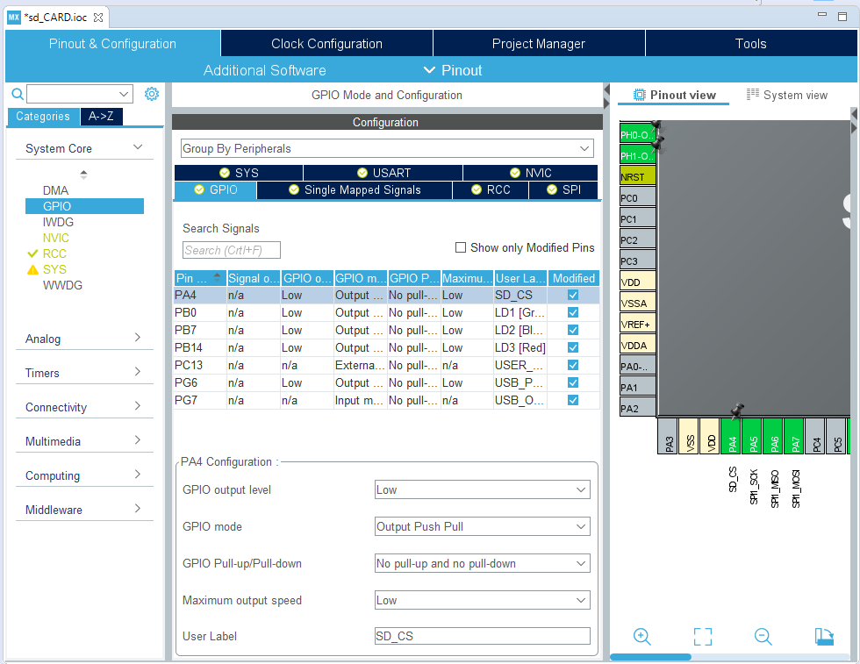

GPIO Configuration
As we described in the before, a CS pin is needed in order to communicate with the SD card.
Go in the GPIO Tab end enable the CS Pin as GPIO OUTPUT (in this case we used the pin PA4).
All the configuration ends here, so now you can generate the code (click on the generate icon ).

Slide 15
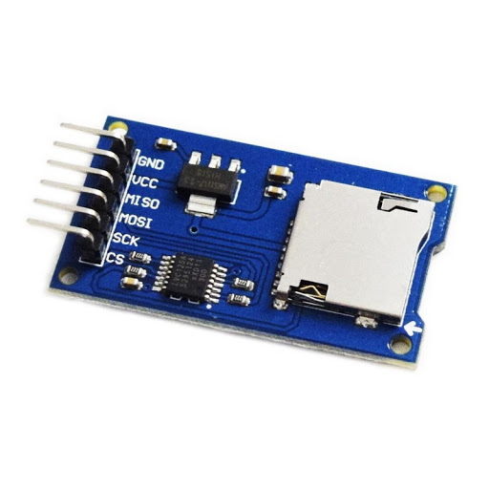
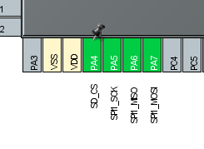
Connect the SD card module
The module used for this example it the following one.
As you can see in the header we have the power pins (GND and VCC) and the SPI communication pins.
Simply connect the pins as :
GND -> GND
VCC -> 5V
MISO -> PA6
MOSI -> PA7
SCK -> PA4
CS -> PA5

Slide 16
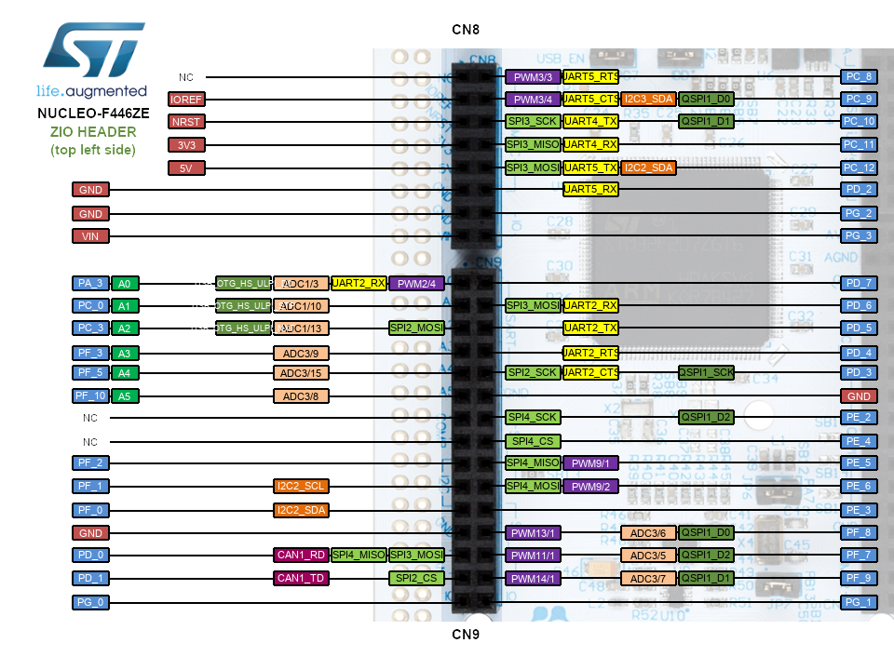
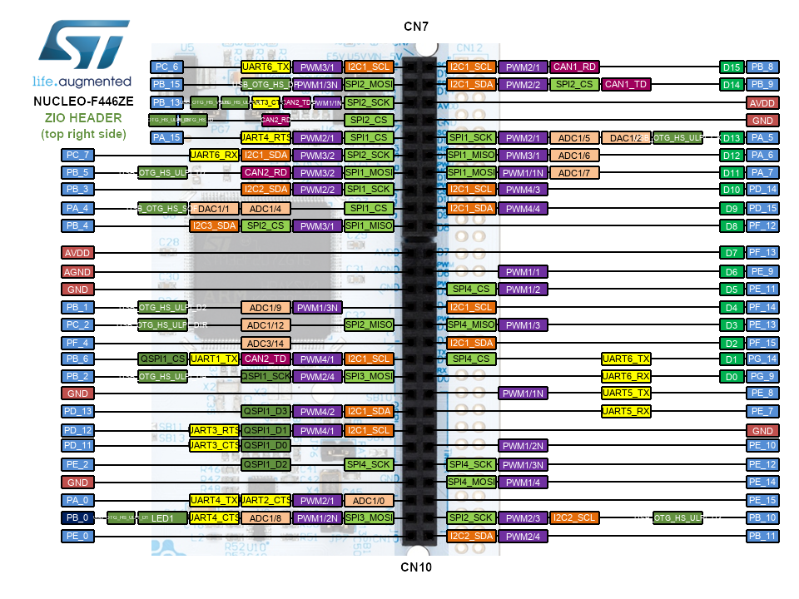
NUCLEO Pins
For more info go here.

Slide 17
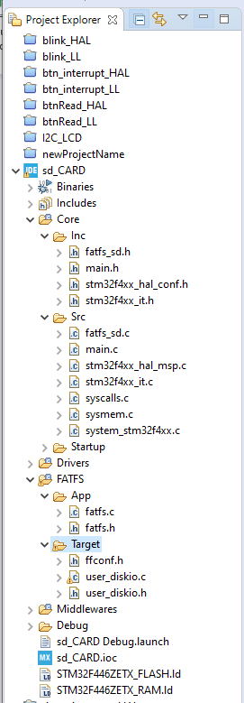
Including the libraries
By the project manager add the following files (just drag & drop them in the correct folder):
fatfs_sd.h
fatfs_sd.c
Replace the following files:
user_diskio.c
stm32f4xx_it.c

Slide 18
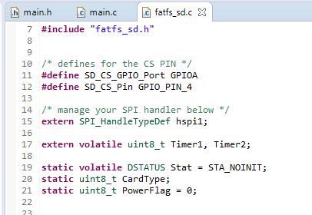
Check the correct CS pin
Open the file fatfs_sd.c and check if the CS pin is the correct one, in our case the CS pin is PA4.
Check the SPI handler too, in our example we used the SPI1.

Slide 19
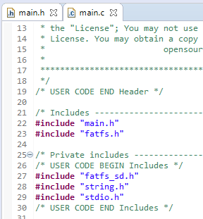
Including the libraries
Open the main.c file and include the following libraries:
fatfs_sd.h
string.h
stdio.h

Slide 20
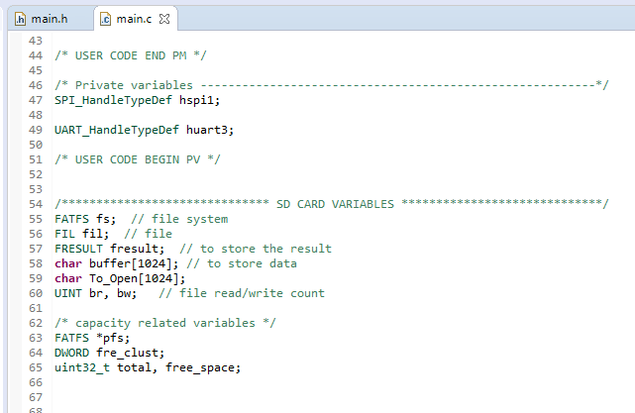
Create variables for SD card
Scroll down and declare the following variables in order to manage the SD Card, them will be useful for check the size of the SD, check for errors or tasks like open, close or remove files.

Slide 21
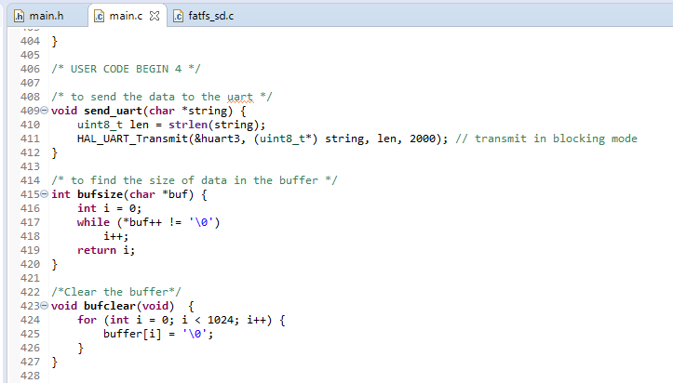
UART Send function
In this example we use the USART Bus to debug our application.
Write the send_uart() function to send string via UART easily, then write the bufsize() and bufclear() functions to manage the buffer.

Slide 22

SD Card functions
Our program should be able to;
Mount the SD card
Check the size of the SD card
Check the free space of the SD card
Open or create a file
Write on a file
Close a file
Eventually it’s possible to delete a file too.

Slide 23
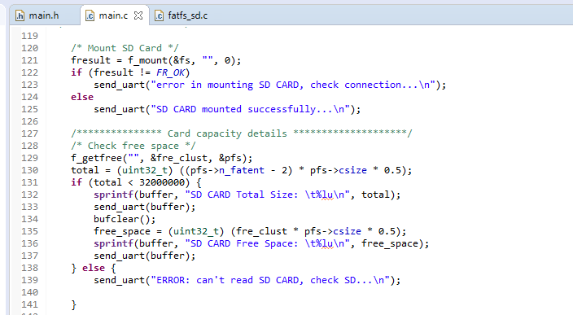
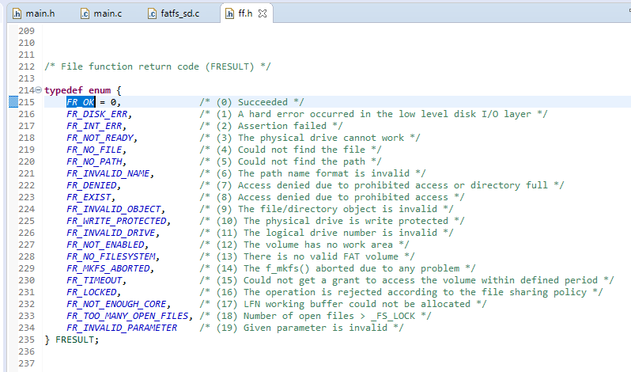
Mount and check capacity
fresult stores the result of the operation, normally should be FR_OK, the other states are defined in ff.h file.
To check the freespace we use the f_getfree() function.
To check if the card has been read correctly we monitor the total capacity, since it should be under 32GB.

Slide 24
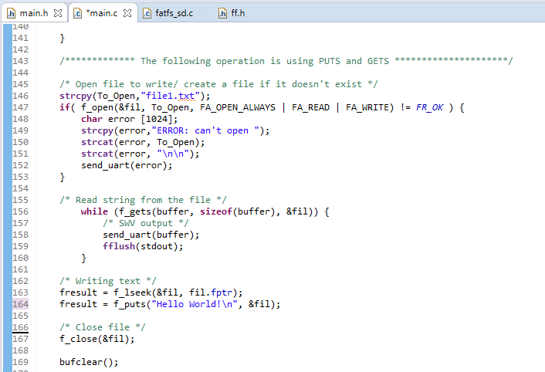
Write and Read from file
In order to open the file use the function f_open(), as always we check for errors.
f_gets() read the entire file, line by line and put it in the buffer.
For write a string in the file, use the function f_puts().
At the end do not forget to close the file and clear the buffer. Use the f_close() and bufclear() functions.
Remember that &fil is the address of our file.

Slide 25
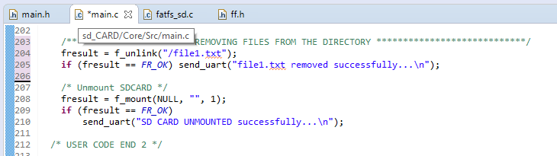
Remove a file
If you want to remove any file from the SD card use the f_unlink() function, check always for errors.
At the end of all operation the SD card should be unmounted, so use the f_mount() function but with the NULL parameter.

Slide 26
Useful links
SD card with stm32 using SPI:
https://www.youtube.com/watch?v=spVIZO-jbxE&t=519s
How spi works:
https://www.youtube.com/watch?v=AuhFr88mjt0
Quad spi for fast operations:
https://www.youtube.com/watch?v=_-FCtJphSRY

